Slide 1
Digital Image Processing
Chapter # 3
Image Transformations and Spatial Filtering

Slide 2
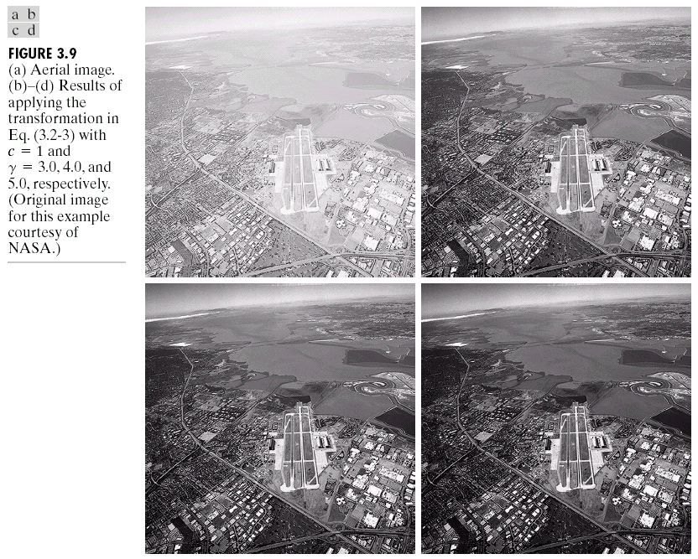
Image Enhancement
2
Notes:
2

Slide 3
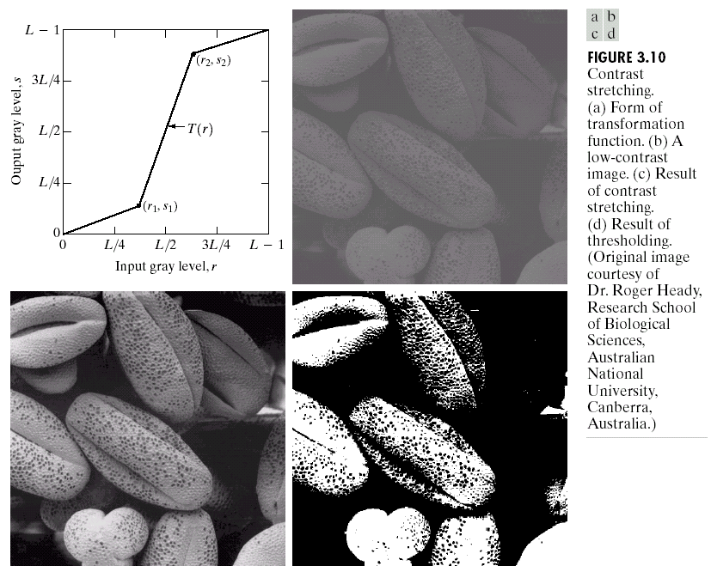
Image Enhancement
3
Notes:
3

Slide 4

Image Enhancement
Process an image so that the result is more suitable than the original image for a specific application
Image Enhancement Methods
Spatial Domain: Direct manipulation of pixels in an image
Transform Domain: Transform the image to some other domain, do the processing and apply inverse transform
This Chapter – Spatial Domain
4
Notes:
4

Slide 5
Types of image enhancement operations
Point/Pixel operations
Output value at specific coordinates (x,y) is dependent only on the input value at (x,y)
Local operations
The output value at (x,y) is dependent on the input values in the neighborhood of (x,y)
Global operations
The output value at (x,y) is dependent on all the values in the input image
5
Notes:
5

Slide 6
Basic Concepts
Most spatial domain enhancement operations can be generalized as:
f (x, y) = the input image
g (x, y) = the processed/output image
T = some operator defined over some neighbourhood of (x, y)
6
Notes:
6

Slide 7
Basic Concepts
A square or rectangular sub-image area centered at (x,y)
Origin
x
(x, y)
y
Image f (x, y)
7
Notes:
7

Slide 8
Point Processing
In a digital image, point = pixel
Point processing transforms a pixel’s value as function of its value alone;
It does not depend on the values of the pixel’s neighbors.
8
Notes:
8

Slide 9
Point Processing
Neighborhood of size 1x1:
g depends only on f at (x,y)
T: Gray-level/intensity transformation/ mapping function
r = gray level of f at (x,y)
s = gray level of g at (x,y)
9
Notes:
9

Slide 10
Point Processing using Look-up Tables
A look-up table (LUT) implements a functional mapping.
255
E.g.:
index
value
...
101
102
103
104
105
106
...
...
64
68
69
70
70
71
...
127
output value
0
0
127
255
input value
input
output
10
Notes:
10

Slide 11
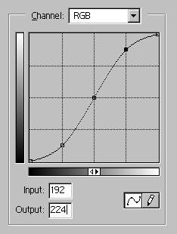
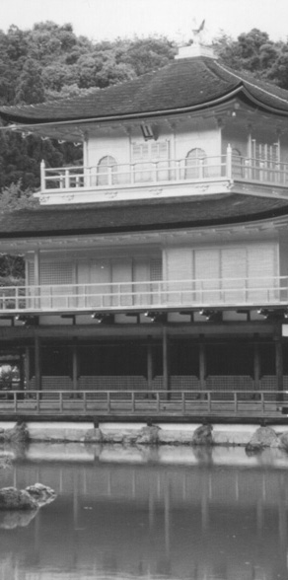
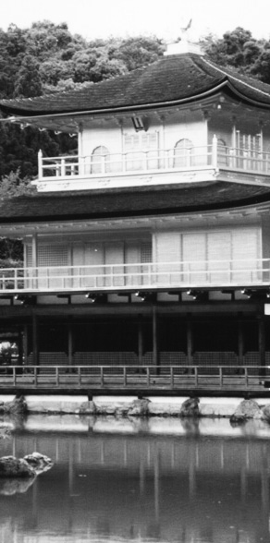
Point Processing using Look-up Tables
input
output
.
.
.
.
.
.
.
.
a pixel with this value
.
.
is mapped to this value
.
.
cell index
contents
.
.
.
.
.
.
.
.
.
.
.
.
11
Notes:
11

Slide 12
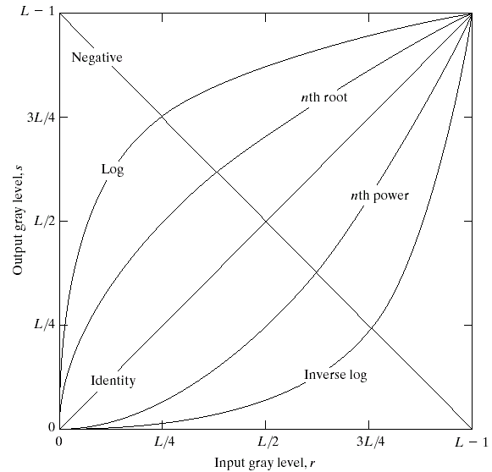
Point Processing Transformations
There are many different kinds of grey level transformations
Three of the most common are shown here
Linear
Negative/Identity
Logarithmic
Log/Inverse log
Power law
n^{th} power/n^{th} root
12
Notes:
12

Slide 13
Point Processing Example: Negative Images
Reverses the gray level order
For L gray levels, the transformation has the form:
Negative images are useful for enhancing white or grey detail embedded in dark regions of an image
13
Notes:
13

Slide 14
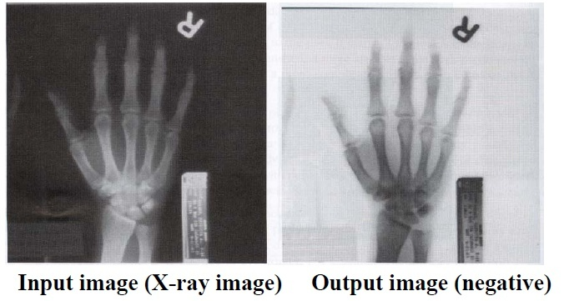
Point Processing Example: Negative Images
14
Notes:
14

Slide 15
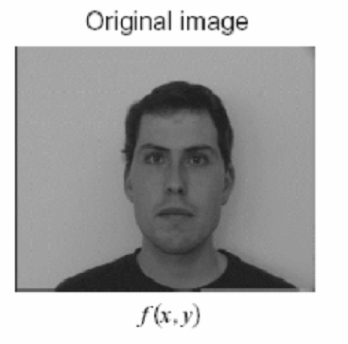
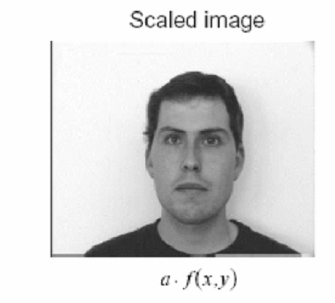
Point Processing Example: Intensity Scaling
15
Notes:
15

Slide 16
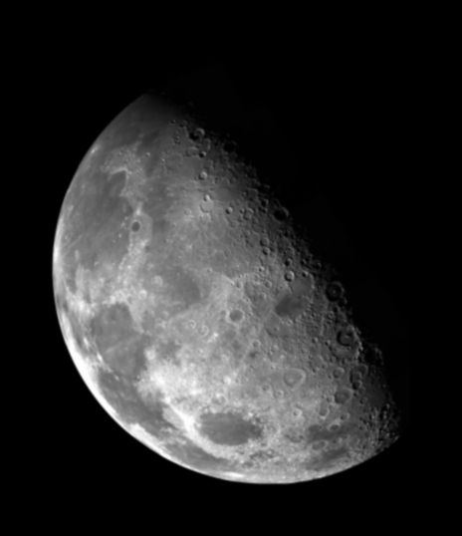
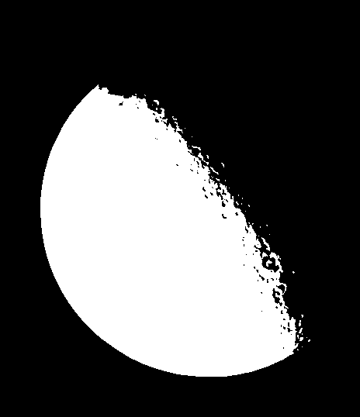
Point Processing Example: Thresholding
Segmentation of an object of interest from a background
1.0
r > threshold
s =
0.0
r <= threshold
16
Notes:
16

Slide 17
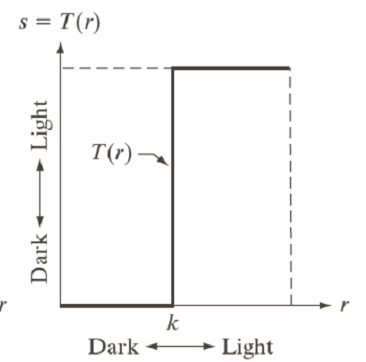
Point Processing Example: Thresholding
1.0 r > threshold
s =
0.0 r <= threshold
17
Notes:
17

Slide 18
Logarithmic Transformations
The general form of the log transformation is
The log transformation maps a narrow range of low input grey level values into a wider range of output values
The inverse log transformation performs the opposite transformation
18
Notes:
18

Slide 19
Logarithmic Transformations
Properties
For lower amplitudes of input image the range of gray levels is expanded
For higher amplitudes of input image the range of gray levels is compressed
19
Notes:
19

Slide 20
Logarithmic Transformations
Application
This transformation is suitable for the case when the dynamic range of a processed image far exceeds the capability of the display device (e.g. display of the Fourier spectrum of an image)
Also called “dynamic-range compression / expansion”
20
Notes:
20

Slide 21
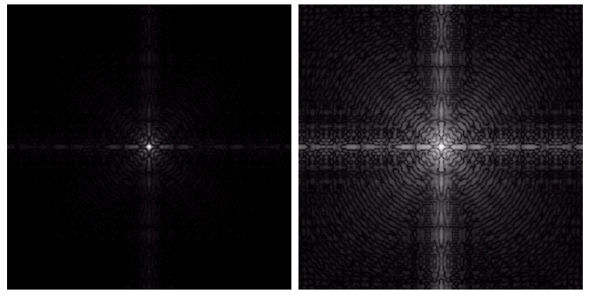
Logarithmic Transformations
Fourier spectrum: image values ranging from 0 to 1.5x10⁶
The result of log transformation with c = 1
21
Notes:
21

Slide 22
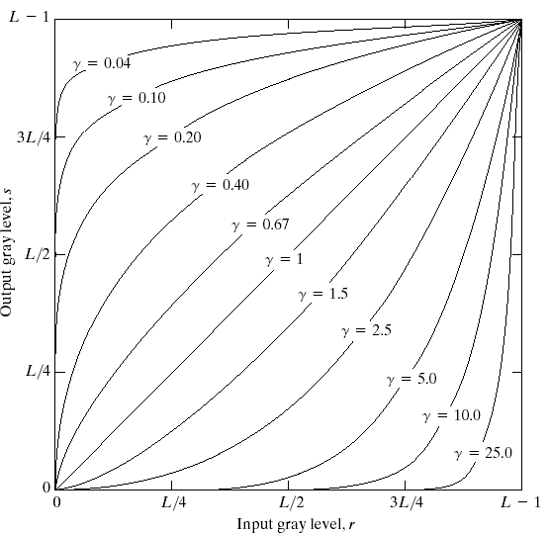
Power Law Transformations
Power law transformations have the following form
Map a narrow range of dark input values into a wider range of output values or vice versa
Varying γ gives a whole family of curves
22
Notes:
22

Slide 23
Power Law Transformations
For γ< 1: Expands values of dark pixels, compress values of brighter pixels
For γ > 1: Compresses values of dark pixels, expand values of brighter pixels
If γ=1 & c=1: Identity transformation (s = r)
A variety of devices (image capture, printing, display) respond according to a power law and need to be corrected
Gamma (γ) correction
The process used to correct the power-law response phenomena
23
Notes:
23

Slide 24
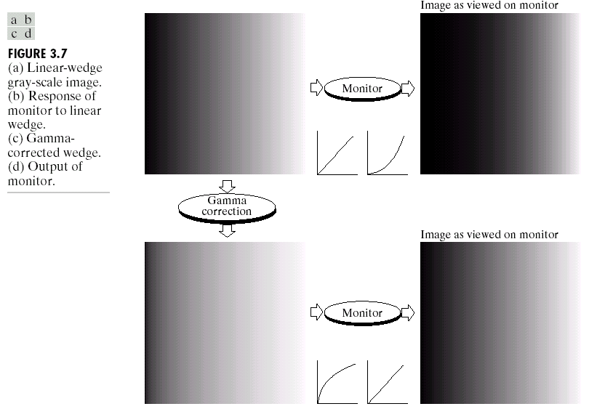
Power Law Transformations: Gamma Correction
24
Notes:
24

Slide 25
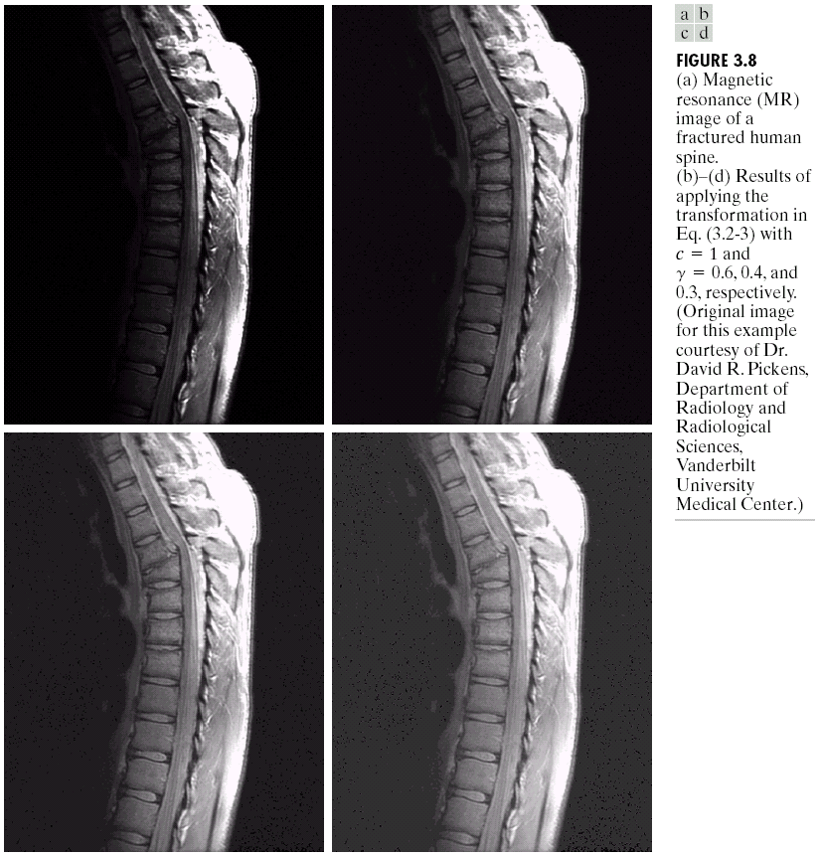
Power Law Transformations Contrast Enhancement
The images to the right show a magnetic resonance (MR) image of a fractured human spine
25
Notes:
25

Slide 26
Power Law Transformations Contrast Enhancement
γ = 0.6
26
Notes:
26

Slide 27
Power Law Transformations Contrast Enhancement
γ = 0.4
27
Notes:
27

Slide 28
Power Law Transformations Contrast Enhancement
γ = 0.3
28
Notes:
28

Slide 29
Power Law Transformations Contrast Enhancement
MR image of
fractured human spine
Result after
Power law transformation
c = 1, γ = 0.6
Result after
Power law transformation
c = 1, γ = 0.4
Result after
Power law transformation
c = 1, γ = 0.3
29
Notes:
29

Slide 30
Power Law Transformations Contrast Enhancement
When the γ is reduced too
much, the image begins to
reduce contrast to the
point where the image
started to have very slight
“wash-out” look.
30
Notes:
30

Slide 31
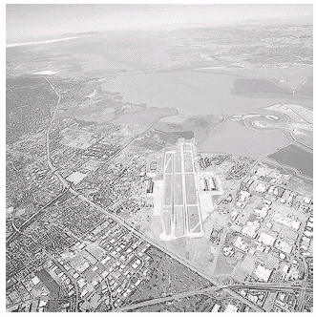
Power Law Transformations Contrast Enhancement
Image has a washed-out
appearance – needs γ > 1
31
Notes:
31

Slide 32
Image Enhancement
Aerial
Image
Result of
Power law transformation
c = 1, γ = 3.0
(suitable)
Result of
Power law transformation
c = 1, γ = 5.0
(high contrast, some regions are too dark)
Result of Power law transformation
c = 1, γ = 4.0
(suitable)
32
Notes:
32

Slide 33
Piecewise Linear Transformation Functions
Contrast stretching
Intensity level slicing
Bit-Plane slicing
33
Notes:
33

Slide 34
Contrast Stretching
Objective
Increase the dynamic range of the gray levels for low contrast images
Rather than using a well defined mathematical function we can use arbitrary user-defined transforms
If r₁ = s₁ & r₂ = s₂, no change in gray levels
If r₁ = r₂, s₁ = 0 & s₂ = L-1, then it is a threshold function. The resulting image is binary
34
Notes:
34

Slide 35
Contrast Stretching
r₁ = r_{min} & s₁ = 0
r₂ = r_{max} & s₂ = L-1
35
Notes:
35

Slide 36
Contrast Stretching
36
Notes:
36

Slide 37
Grey Level Slicing
Highlights a specific range of gray levels in an image
Similar to thresholding
Other levels can be suppressed or maintained
Useful for highlighting features in an image
37
Notes:
37

Slide 38
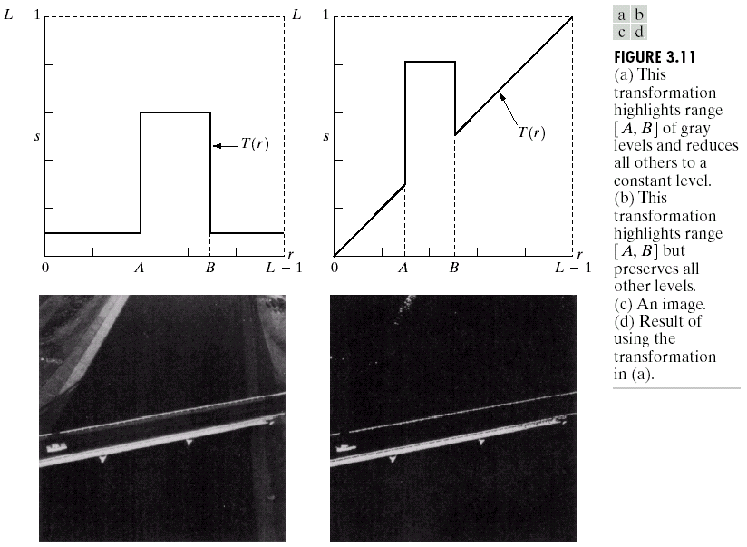
Grey Level Slicing
Highlights range [A,B] of gray levels and reduces all others to a contrast level
Highlights range [A,B] but preserves all other gray levels
38
Notes:
38

Slide 39
Grey Level Slicing
39
Notes:
39

Slide 40
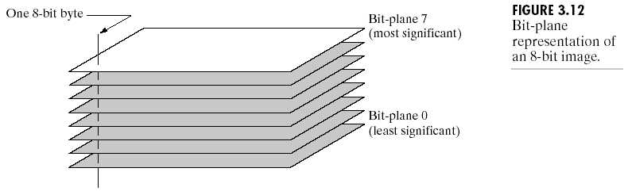
Bit Plane Slicing
Objective: Highlights the contribution made to the image appearance by specific bits
Suppose an image is of 8 bits i.e. each pixel is represented by 8 bits
Higher-order bits contain the majority of the visually significant data
Useful for analyzing the relative importance played by each bit of the image. It is useful in compression
40
Notes:
40

Slide 41

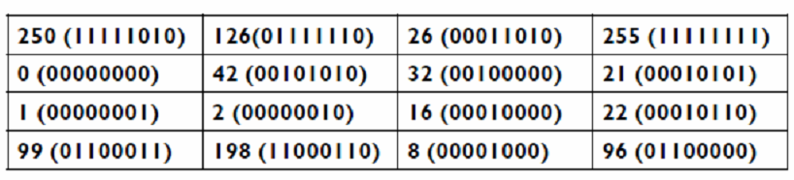
Bit Plane Slicing
41
Notes:
41

Slide 42
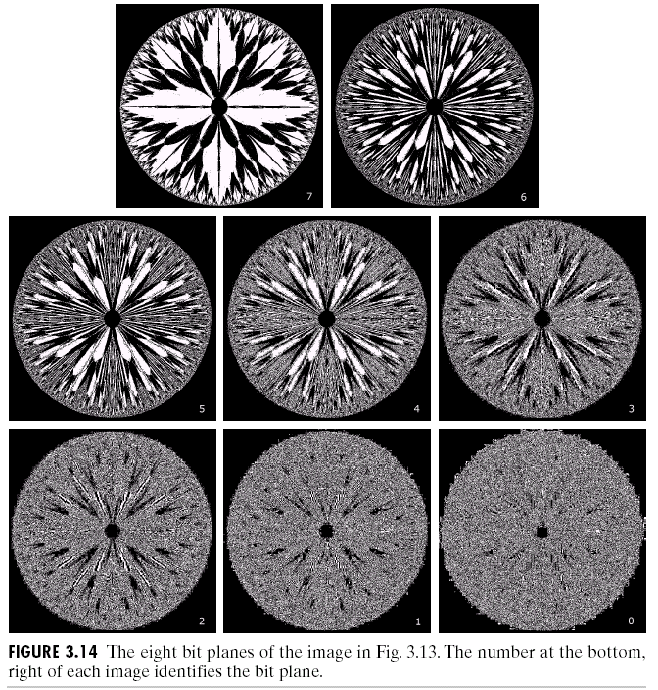
Image Enhancement
[10000000]
[01000000]
[00100000]
[00001000]
[00000100]
[00000001]
42
Notes:
42

Slide 43
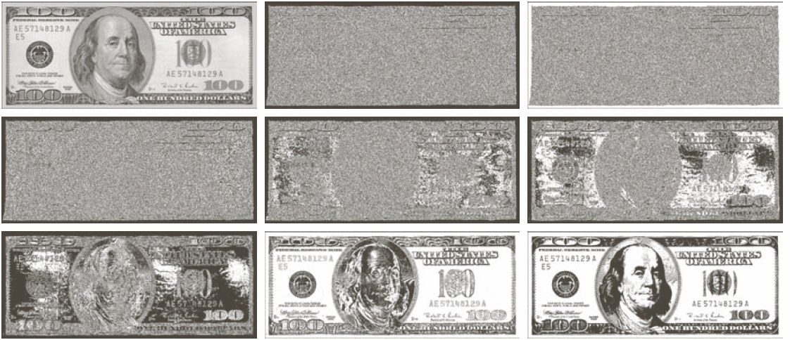
Bit Plane Slicing
Bit planes 1 through 8
43
Notes:
43

Slide 44
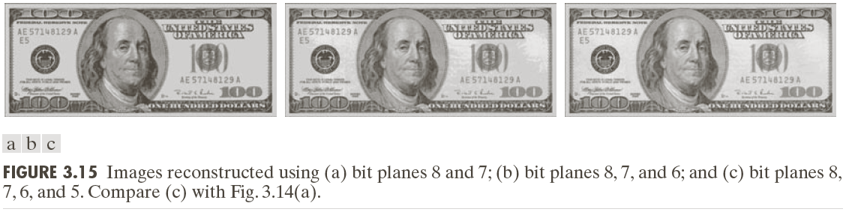
Bit Plane Slicing
Reconstructed image using only bit planes 8 and 7
Reconstructed image using only bit planes 8, 7 and 6
Reconstructed image using only bit planes 7, 6 and 5
44
Notes:
44

Slide 45
Histogram of a Grayscale Image
Let I be a 1-band (grayscale) image.
I(r,c) is an 8-bit integer between 0 and 255.
Histogram, h_{I}, of I:
a 256-element array, h_{I}
h_{I} (g) = number of pixels in I that have value g.
for g = 0,1, 2, 3, …, 255
45
Notes:
45

Slide 46
Histogram of a Grayscale Image
Histogram of a digital image with gray levels in the range [0,L-1] is a discrete function
Where
r_{k} = k^{th} gray level
n_{k} = number of pixels in the image having gray level r_{k}
h(r_{k}) = histogram of an image having r_{k} gray levels
46
Notes:
46

Slide 47
Normalized Histogram
Dividing each of histogram at gray level r_{k} by the total number of pixels in the image, n
p(r_{k}) gives an estimate of the probability of
occurrence of gray level r_{k}
The sum of all components of a normalized
histogram is equal to 1
47
Notes:
47

Slide 48
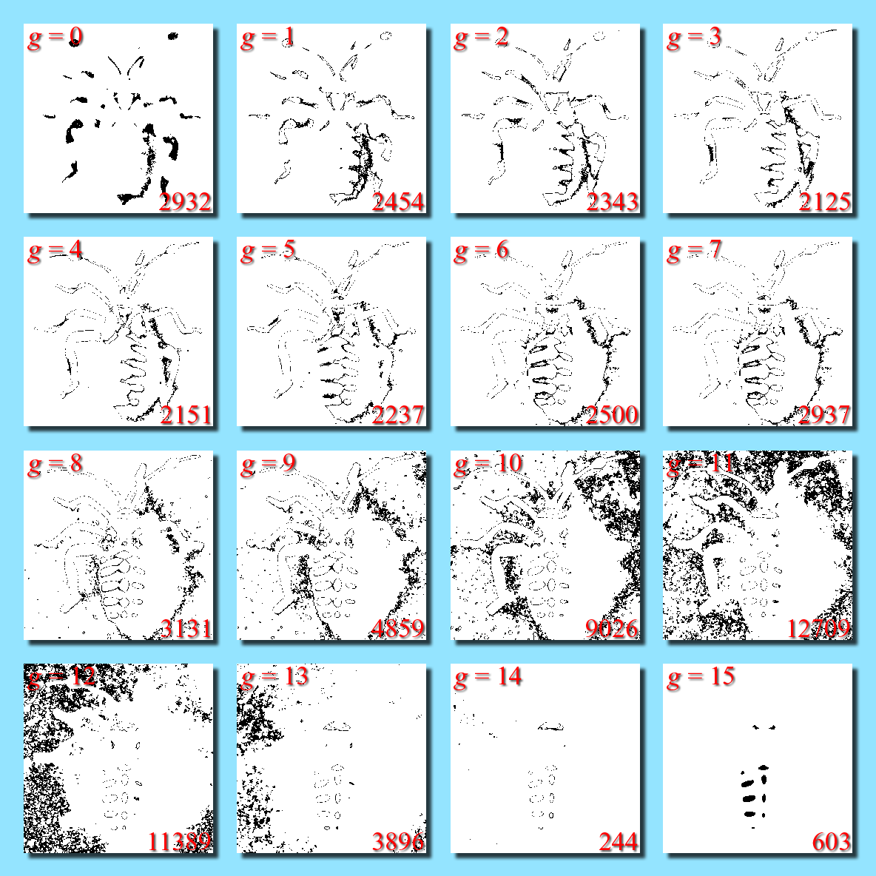
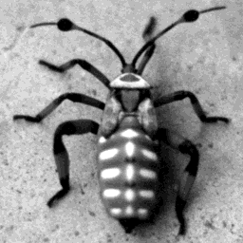
Histogram of a Grayscale Image
lower RHC: number of pixels with intensity g
black marks pixels with intensity g
16-level (4-bit) image
48
Notes:
48

Slide 49
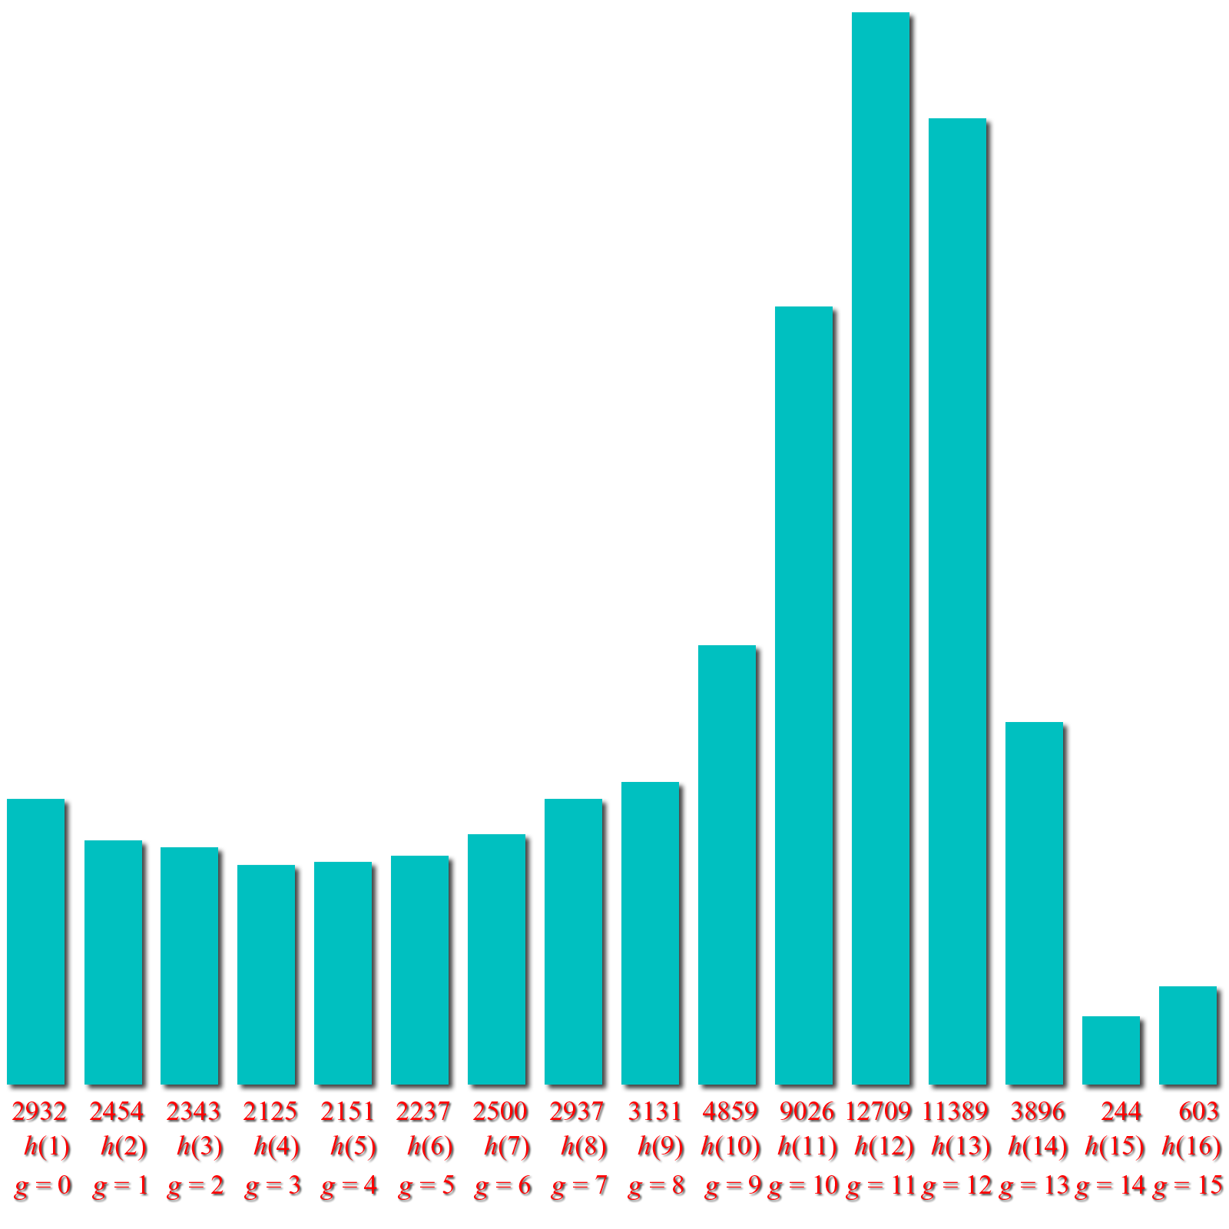
Histogram of a Grayscale Image
Black marks pixels with intensity g
Plot of histogram:
number of pixels with intensity g
49
Notes:
49

Slide 50
Histogram of a Grayscale Image
Black marks pixels with intensity g
Plot of histogram:
number of pixels with intensity g
50
Notes:
50

Slide 51
Histogram of a Color Image
If I is a 3-band image
then I(r,c,b) is an integer between 0 and 255.
I has 3 histograms:
h_{R}(g) = # of pixels in I(:,:,1) with intensity value g
h_{G}(g) = # of pixels in I(:,:,2) with intensity value g
h_{B}(g) = # of pixels in I(:,:,3) with intensity value g
51
Notes:
51

Slide 52
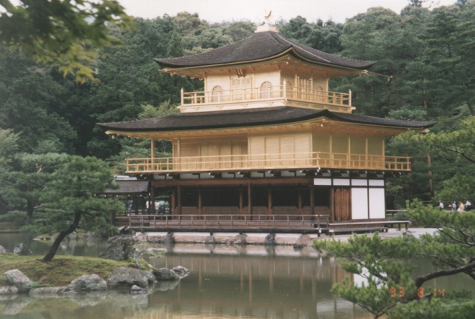
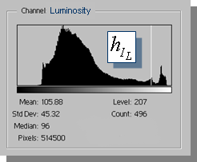
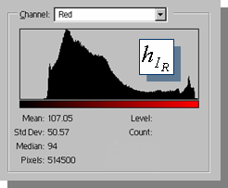
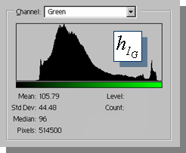
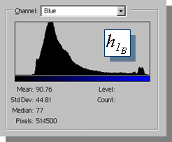
Histogram of a Color Image
There is one histo-gram per color band
R, G, & B. Luminosity histogram is from 1 band = (R+G+B)/3
52
Notes:
52

Slide 53
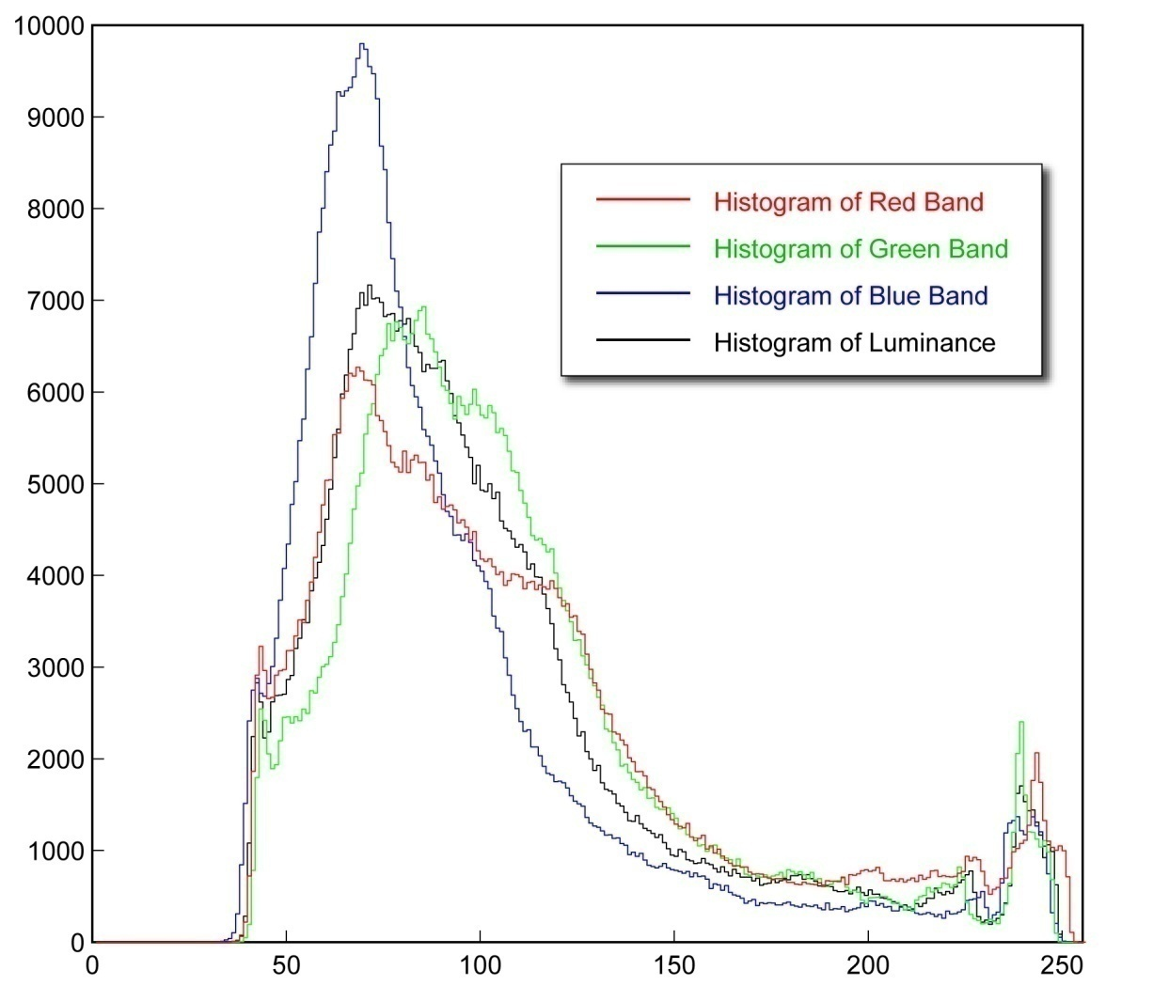
Histogram of a Color Image
53
Notes:
53

Slide 54
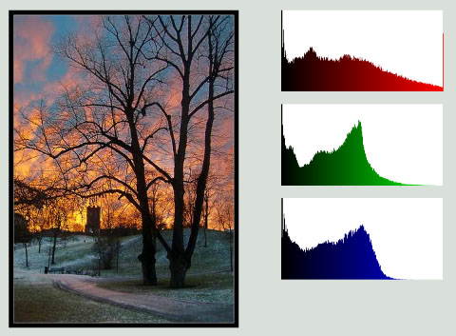
Histogram of a Color Image
54
Notes:
54

Slide 55
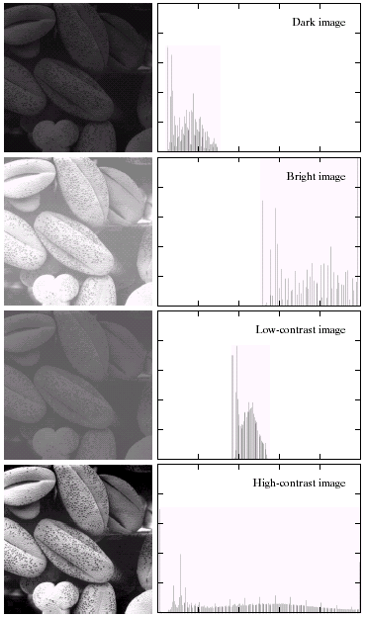
Histogram: Example
Dark Image
How would the histograms of these images look like?
Bright Image
55
Notes:
55

Slide 56
Histogram: Example
Dark image
Components of
histogram are
concentrated on the low side of the gray scale
Bright image
Components of
histogram are
concentrated on the high side of the gray scale
56
Notes:
56

Slide 57
Histogram: Example
Low Contrast Image
How would the histograms of these images look like?
High Contrast Image
57
Notes:
57

Slide 58
Histogram: Example
Low contrast image
Histogram is narrow and centered toward the middle of the gray scale
High contrast image
Histogram covers broad range of the gray scale and the distribution of pixels is not too far from uniform with very few
vertical lines being much higher than the others
58
Notes:
58

Slide 59
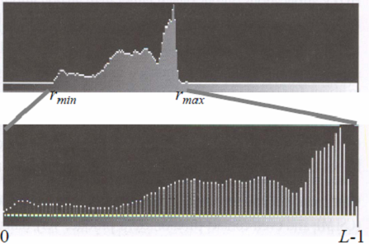
Contrast Stretching
Improve the contrast in an image by `stretching' the range of intensity values it contains to span a desired range of values, e.g. the the full range of pixel values
59
Notes:
59

Slide 60
Contrast Stretching
If r_{max} and r_{min} are the maximum and minimum gray level of the input image and L is the total gray levels of output image, the transformation function for contrast stretch will be
L
255
127
0
0
r_{min}
127
r_{max}
255
60
Notes:
60

Slide 61


Contrast Stretching
61
Notes:
61

Slide 62
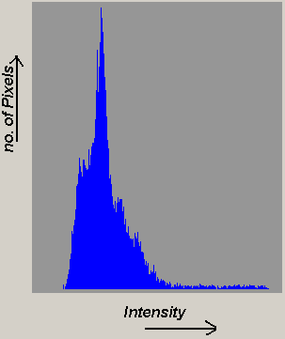
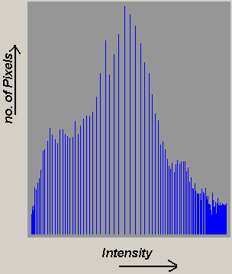
Histogram Equalization
Histogram equalization re-assigns the intensity values of pixels in the input image such that the output image contains a uniform distribution of intensities
62
Notes:
62

Slide 63

The Probability Distribution Function of an Image
This is the probability that an arbitrary pixel from I has value g.
63
Notes:
63

Slide 64
The Probability Distribution Function of an Image
p(g) is the fraction of pixels in an image that have intensity value g.
p(g) is the probability that a pixel randomly selected from the given image has intensity value g.
Whereas the sum of the histogram h(g) over all g from 0 to 255 is equal to the number of pixels in the image, the sum of p(g) over all g is 1.
p is the normalized histogram of the image
64
Notes:
64

Slide 65
The Cumulative Distribution Function of an Image
Let q = I(r,c) be the value of a randomly selected pixel from I. Let g be a specific gray level. The probability that q ≤ g is given by
where h_{I}(γ ) is the histogram of image I.
This is the probability that any given pixel from I has value less than or equal to g.
65
Notes:
65

Slide 66
The Cumulative Distribution Function of an Image
Let q = I(r,c) be the value of a randomly selected pixel from I. Let g be a specific gray level. The probability that q ≤ g is given by
Also called CDF for “Cumulative Distribution Function”.
where h_{I}(γ ) is the histogram of image I.
This is the probability that any given pixel from I has value less than or equal to g.
66
Notes:
66

Slide 67
The Cumulative Distribution Function of an Image
P(g) is the fraction of pixels in an image that have intensity values less than or equal to g.
P(g) is the probability that a pixel randomly selected from the given band has an intensity value less than or equal to g.
P(g) is the cumulative (or running) sum of p(g) from 0 through g inclusive.
P(0) = p(0) and P(255) = 1;
67
Notes:
67

Slide 68
Histogram Equalization
Task: remap image I so that its histogram is as close to constant as possible
be the cumulative (probability) distribution function of I.
The CDF itself is used as the LUT.
68
Notes:
68

Slide 69
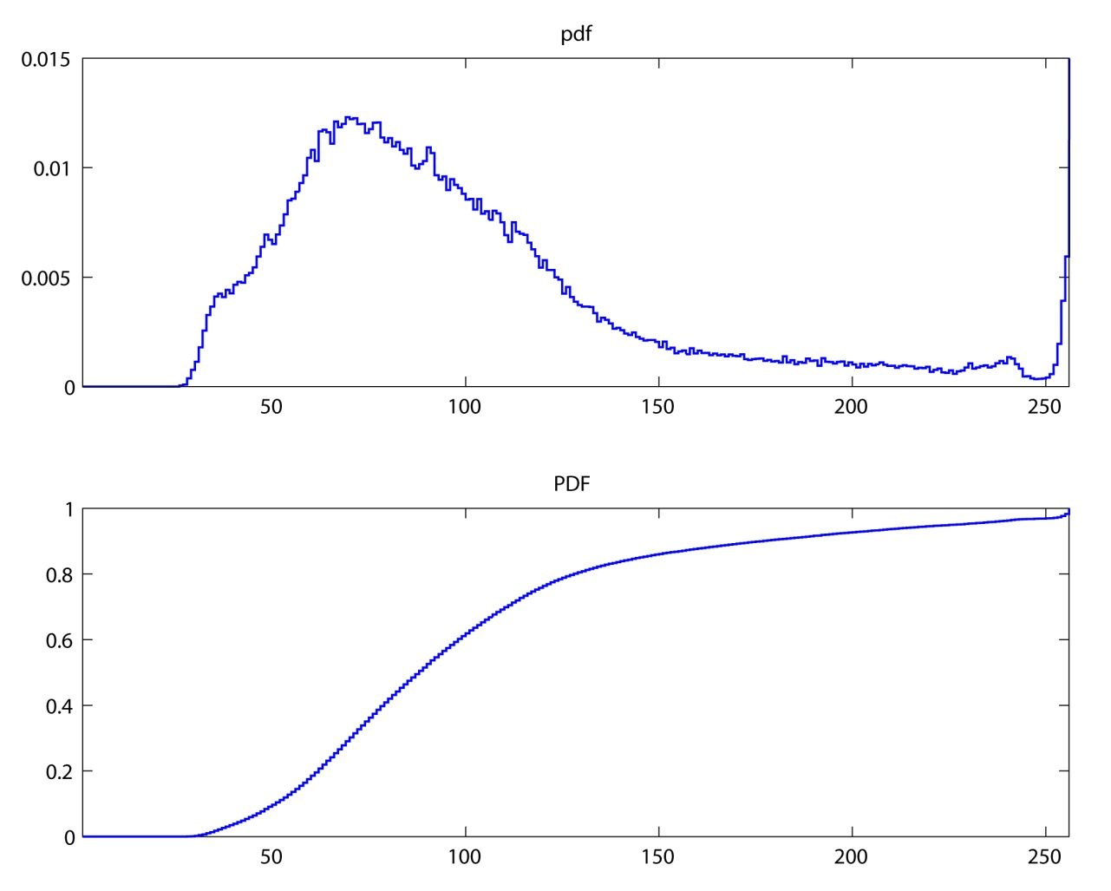

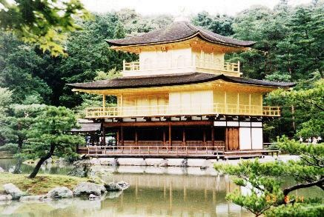
Histogram Equalization
The CDF (cumulative distribution) is the LUT for remapping.
pdf
CDF
69
Notes:
69

Slide 70
Histogram Equalization
The CDF (cumulative distribution) is the LUT for remapping.
pdf
LUT
70
Notes:
70

Slide 71
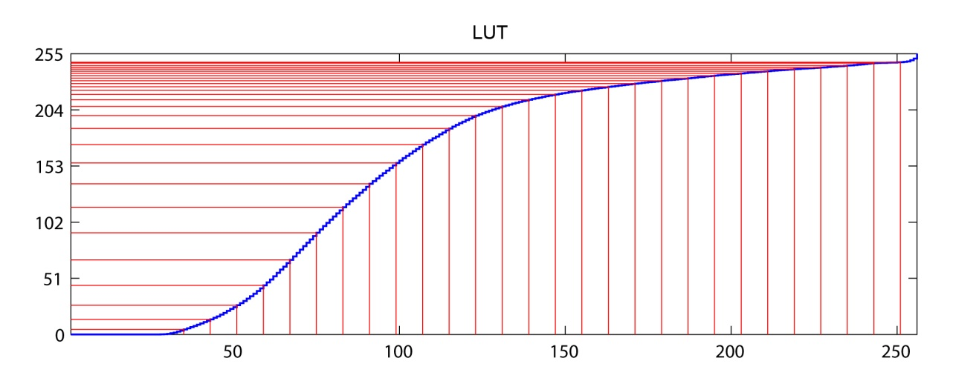
Histogram Equalization
The CDF (cumulative distribution) is the LUT for remapping.
pdf
LUT
71
Notes:
71

Slide 72
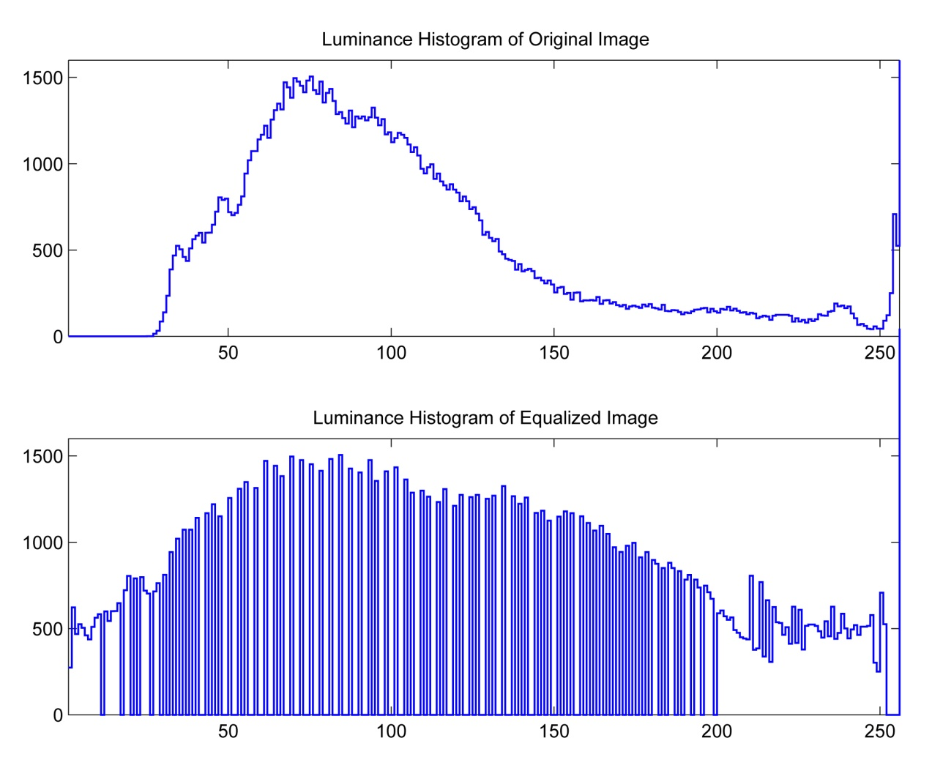
Histogram Equalization
72
Notes:
72

Slide 73
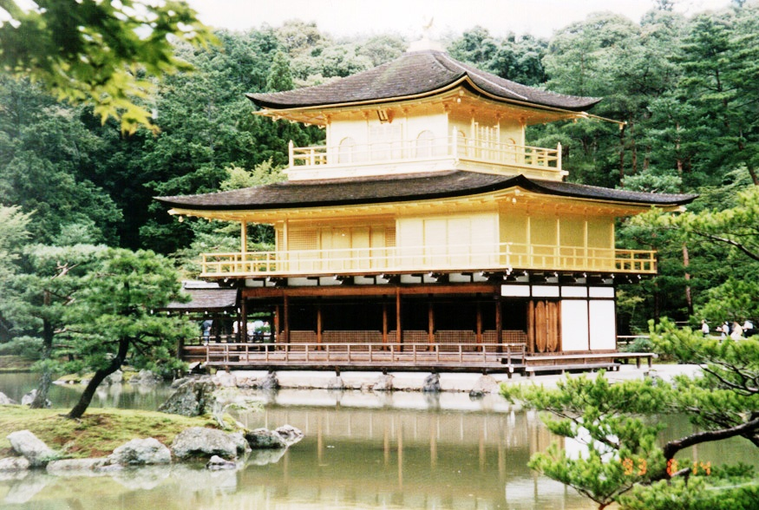
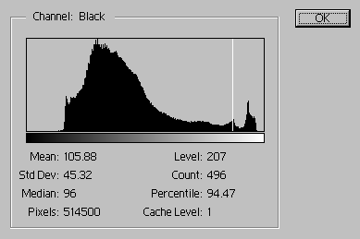
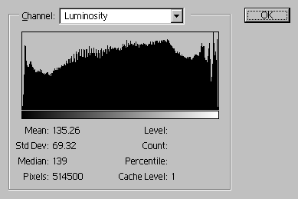
Histogram Equalization
Luminosity
before
after
73
Notes:
73

Slide 74
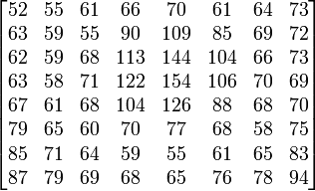

Histogram Equalization: Example
An 8x8 image
74
Notes:
74

Slide 75

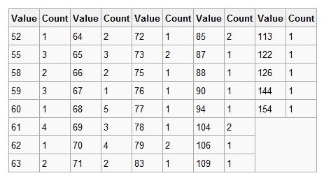
Histogram Equalization: Example
Fill in the following table/histogram
Image Histogram (Non-zero values)
75
Notes:
75

Slide 76
Histogram Equalization: Example
Image Histogram (Non-zero values shown)
76
Notes:
76

Slide 77
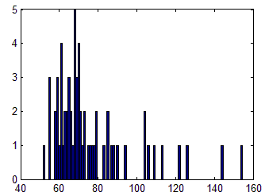
Histogram Equalization: Example
77
Notes:
77

Slide 78
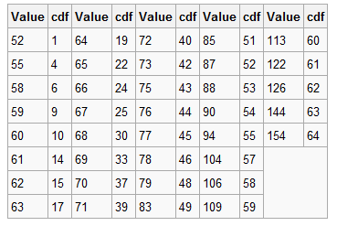
Histogram Equalization: Example
Cumulative Distribution Function (cdf)
Image Histogram/Prob Mass Function
78
Notes:
78

Slide 79
Histogram Equalization: Example
Cumulative Distribution Function (cdf)
79
Notes:
79

Slide 80
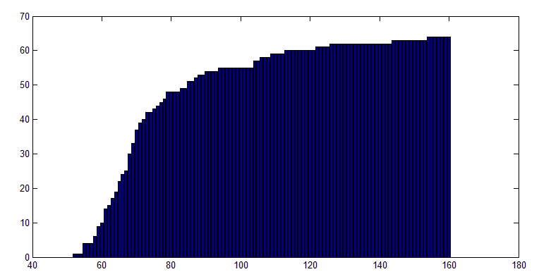
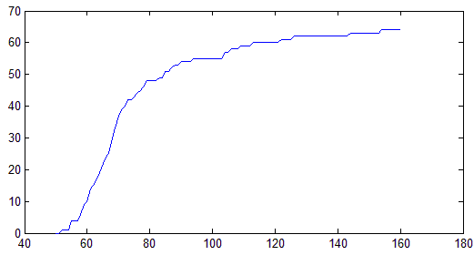
Histogram Equalization: Example
Cumulative Distribution Function (cdf)
80
Notes:
80

Slide 81

Histogram Equalization: Example
Normalized Cumulative Distribution Function (cdf)
Divide each value by total number of pixels (64) to get the normalized cdf
81
Notes:
81

Slide 82
Histogram Equalization: Example
If cdf is normalized
If cdf is NOT normalized
 |  |  |  |  |  | 183
Original Image
82
Notes:
82

Slide 83

Histogram Equalization: Example
83
Notes:
83

Slide 84




Histogram Equalization: Example
Original Image
Corresponding histogram (red) and cumulative histogram (black)
Image after histogram equalization
Corresponding histogram (red) and cumulative histogram (black)
84
Notes:
84

Slide 85


Histogram Equalization: Example
Equalized Histogram
Dark image
Bright image
Equalized Histogram
85
Notes:
85

Slide 86

Histogram Equalization: Example
Equalized Histogram
Low contrast
High Contrast
Equalized Histogram
86
Notes:
86

Slide 87
Histogram Equalization vs. Contrast Stretching
Histogram equalization is sophisticated version of contrast stretching
Contrast Stretching – Enhancement is less harsh

Slide 88

Histogram Equalization vs. Contrast Stretching
Original Image
Contrast Stretching
Histogram Equalization
Dramatic Enhancement - Artificial look

Slide 89



Histogram Equalization vs. Contrast Stretching
Original Image
Contrast Stretching
Histogram Equalization

Slide 90
Spatial Filtering

Slide 91

Spatial Filtering
91
Notes:
91

Slide 92

Spatial Filtering
92
Notes:
92

Slide 93
Spatial Filtering: Basics
Origin
x
Neighbourhood operations: Operate on a larger neighbourhood of pixels than point operations
(x, y)
Neighbourhood
Neighbourhoods are mostly a rectangle around a central pixel
y
Image f (x, y)
93
Notes:
93

Slide 94
Spatial Filtering: Basics
Original Image
x
Enhanced Image
x
123
127
128
119
115
130
140
145
148
153
167
172
133
154
183
192
194
191
194
199
207
210
198
195
164
170
175
162
173
151
y
y
94
Notes:
94

Slide 95
Spatial Filtering: Basics
Origin
x
a
b
c
r
s
t
d
e
f
*
u
v
w
g
h
i
x
y
z
Original Image Pixels
Filter
Simple 3*3 Neighbourhood
e
3*3 Filter
e_{processed} = v*e + r*a + s*b + t*c + u*d + w*f + x*g + y*h + z*i
y
Image f (x, y)
The above is repeated for every pixel in the original image to generate the filtered image
95
Notes:
95

Slide 96
Spatial Filtering: Basics
Moving window (kernel) scans the 3x3 neighborhood of every pixel in the image
Original Image
96
Notes:
96

Slide 97
Spatial Filtering: Basics
97
Notes:
97

Slide 98

Spatial Filtering: Basics
98
Notes:
98

Slide 99
Spatial Filtering: Basics
99
Notes:
99

Slide 100
Spatial Filtering: Basics
100
Notes:
100

Slide 101
Spatial Filtering: Basics
101
Notes:
101

Slide 102
Spatial Filtering: Basics
Mask operation near the image border: Problem arises when part of the mask is located outside the image plane
Discard the problem pixels (e.g. 512x512 input 510x510 output if mask size is 3x3)
Pixel replication: We normally use the gray levels of border pixels to fill up the expanded region (for 3x3 mask). For larger masks a border region equal to half of the mask size is mirrored on the expanded region.
Zero padding: Expand the input image by padding zeros (512x512 original image, 514x514 padded image, 512x512 output)
Zero padding is not recommended as it creates artificial lines or edges on the border
102
Notes:
102

Slide 103
Mask operation near the border: Pixel replication
103
Notes:
103

Slide 104
Spatial Filtering: Basics
The output intensity value at (x,y) depends not only on the input intensity value at (x,y) but also on the specified number of neighboring intensity values around (x,y)
Spatial masks (also called window, filter, kernel, template) are used and convolved over the entire image for local enhancement (spatial filtering)
The size of the masks determines the number of neighboring pixels which influence the output value at (x,y)
The values (coefficients) of the mask determine the nature and properties of enhancing technique
104
Notes:
104

Slide 105

Spatial Filtering: Basics
Filtering can be given in equation form as shown above
105
Notes:
105

Slide 106
Spatial Filtering: Basics
Given the 3×3 mask with coefficients: w₁, w₂,…, w₉
The mask cover the pixels with gray levels: z₁, z₂,…, z₉
z gives the output intensity value for the processed image (to be stored in a new array) at the location of z₅ in the input image
w₁ | w₂ | w₃
w₄ | w₅ | w₆
w₇ | w₈ | w₉
z₁ | z₂ | z₃
z₄ | z₅ | z₆
z₇ | z₈ | z₉
106
Notes:
106

Slide 107
Smoothing Spatial Filters
For blurring/noise reduction
Blurring is usually used in preprocessing steps, e.g., to remove small details from an image prior to object extraction, or to bridge small gaps in lines or curves
Equivalent to Low-pass spatial filtering in frequency domain because smaller (high frequency) details are removed based on neighborhood averaging (averaging filters)
107
Notes:
107

Slide 108
Smoothing Spatial Filters
Simply average all of the pixels in a neighbourhood around a central value
¹/₉ | ¹/₉ | ¹/₉
¹/₉ | ¹/₉ | ¹/₉
¹/₉ | ¹/₉ | ¹/₉
Simple averaging filter
108
Notes:
108

Slide 109
Spatial Filtering: Basics
Origin
x
104
100
108
¹/₉
¹/₉
¹/₉
99
106
98
*
¹/₉
¹/₉
¹/₉
95
90
85
¹/₉
¹/₉
¹/₉
Original Image Pixels
Filter
¹/₉
¹/₉
¹/₉
Simple 3*3 Neighbourhood
104
100
108
3*3 Smoothing Filter
¹/₉
¹/₉
¹/₉
99
106
98
¹/₉
¹/₉
¹/₉
95
90
85
e = ¹/₉*106 + ¹/₉*104 + ¹/₉*100 + ¹/₉*108 + ¹/₉*99 + ¹/₉*98 + ¹/₉*95 + ¹/₉*90 + ¹/₉*85
= 98.3333
y
Image f (x, y)
The above is repeated for every pixel in the original image to generate the smoothed image
109
Notes:
109

Slide 110

Smoothing Spatial Filters
Consider the output pixel is positioned at the center
Box Filter all coefficients are equal
Weighted Average give more (less) weight to near (away from) the output location
110
Notes:
110

Slide 111


Smoothing Filter: Example
original
3x3 average
111
Notes:
111

Slide 112


Smoothing Filter: Example
original
3x3 average
112
Notes:
112

Slide 113


Smoothing Filter: Example
original
3x3 average
113
Notes:
113

Slide 114


Smoothing Filter: Example
original
3x3 average
114
Notes:
114

Slide 115

Original image
Size: 500x500
Smooth by 3x3 box filter
Smooth by 5x5 box filter
Smooth by 9x9 box filter
Smooth by 35x35 box filter
Smooth by 15x15 box filter
Notice how detail begins to disappear
115
Notes:
115

Slide 116
Order-Statistic Filtering
Output is based on order of gray levels in the masked area
Some simple neighbourhood operations include:
Min: Set the pixel value to the minimum in the neighbourhood
Max: Set the pixel value to the maximum in the neighbourhood
Median: The median value of a set of numbers is the midpoint value in that set
116
Notes:
116

Slide 117
Median Filtering
Sort the values
Determine the median
20
Median = ?
Particularly effective when
The noise pattern consists of strong impulse noise ( salt-and-pepper)
117
Notes:
117

Slide 118


Salt and Pepper Noise

Slide 119
Median Filtering
119
Notes:
119

Slide 120


Median Filtering
Noisy
Original

Slide 121
Median Filtering
Noisy
Noisy

Slide 122


Median Filtering
3x3-blur x 1
3x3-median x 1

Slide 123


Median Filtering
3x3-blur x 2
3x3-median x 2

Slide 124


Median Filtering
3x3-blur x 5
3x3-median x 5

Slide 125


Median Filtering
3x3-blur x 10
3x3-median x 10

Slide 126
Sharpening Spatial Filters
Previously we have looked at smoothing filters which remove fine detail
Sharpening spatial filters seek to highlight fine detail
Remove blurring from images
Highlight edges
Sharpening filters are based on spatial differentiation

Slide 127

Spatial Differentiation
Let’s consider a simple 1 dimensional example

Slide 128
Spatial Differentiation
A
B

Slide 129
1st Derivative
The 1st derivative of a function is given by:
Its just the difference between subsequent values and measures the rate of change of the function

Slide 130
1st Derivative
5 | 5 | 4 | 3 | 2 | 1 | 0 | 0 | 0 | 6 | 0 | 0 | 0 | 0 | 1 | 3 | 1 | 0 | 0 | 0 | 0 | 7 | 7 | 7 | 7
 | -1 | -1 | -1 | -1 | -1 | 0 | 0 | 6 | -6 | 0 | 0 | 0 | 1 | 2 | -2 | -1 | 0 | 0 | 0 | 7 | 0 | 0 | 0

Slide 131
2nd Derivative
The 2nd derivative of a function is given by:
Simply takes into account the values both before and after the current value

Slide 132
2nd Derivative
5 | 5 | 4 | 3 | 2 | 1 | 0 | 0 | 0 | 6 | 0 | 0 | 0 | 0 | 1 | 3 | 1 | 0 | 0 | 0 | 0 | 7 | 7 | 7 | 7
 | -1 | 0 | 0 | 0 | 0 | 1 | 0 | 6 | -12 | 6 | 0 | 0 | 1 | 1 | -4 | 1 | 1 | 0 | 0 | 7 | -7 | 0 | 0

Slide 133
2nd Derivative for Image Enhancement
The 2nd derivative is more useful for image enhancement than the 1st derivative - Stronger response to fine detail
We will come back to the 1st order derivative later on
The first sharpening filter we will look at is the Laplacian

Slide 134
Laplacian Filter
The Laplacian is defined as follows:

Slide 135
Laplacian Filter
So, the Laplacian can be given as follows:
0
1
0
Can we implement it using a filter/ mask?
1
-4
1
0
1
0

Slide 136

Laplacian Filter

Slide 137

Laplacian Filter
Applying the Laplacian to an image we get a new image that highlights edges and other discontinuities
Original Image
Laplacian Filtered Image
Laplacian Filtered Image Scaled for Display

Slide 138

Laplacian Image Enhancement
The result of a Laplacian filtering is not an enhanced image
To generate the final enhanced image

Slide 139
Laplacian Image Enhancement
-
=
Original Image
Laplacian Filtered Image
Sharpened Image
In the final sharpened image edges and fine detail are much more obvious

Slide 140
Laplacian Image Enhancement

Slide 141
Simplified Image Enhancement
The entire enhancement can be combined into a single filtering operation

Slide 142
Simplified Image Enhancement
The entire enhancement can be combined into a single filtering operation
0
-1
0
-1
5
-1
0
-1
0

Slide 143

Simplified Image Enhancement
This gives us a new filter which does the whole job for us in one step
0
-1
0
-1
5
-1
0
-1
0

Slide 144
Use of first derivatives for image enhancement: The Gradient
The gradient of a function f(x,y) is defined as

Slide 145
Use of first derivatives for image enhancement: The Gradient
The magnitude of this vector is given by:
For practical reasons this can be simplified as:

Slide 146

Gradient Operators
There is some debate as to how best to calculate these gradients
Simplest Operator
y
x

Slide 147
Gradient Operators
Prewitt Operator
-1 | -1 | -1
0 | 0 | 0
1 | 1 | 1
-1 | 0 | 1
-1 | 0 | 1
-1 | 0 | 1
Extract horizontal edges
Extract vertical edges

Slide 148
Gradient Operators
Sobel Operator
-1 | -2 | -1
0 | 0 | 0
1 | 2 | 1
-1 | 0 | 1
-2 | 0 | 2
-1 | 0 | 1
Extract horizontal edges
Extract vertical edges
Emphasize more the current point (x direction)
Emphasize more the current point (y direction)
Pixel Arrangement

Slide 149

Sobel Operator: Example
Sobel filters are typically used for edge detection
An image of a contact lens which is enhanced in order to make defects more obvious

Slide 150

Combining Spatial Enhancement Methods
Successful image enhancement is typically not achieved using a single operation
Rather we combine a range of techniques in order to achieve a final result
This example will focus on enhancing the bone scan

Slide 151
Combining Spatial Enhancement Methods
(a)
Laplacian filter of bone scan (a)
(b)
Sharpened version of bone scan achieved by subtracting (a) and (b)
(c)
Sobel filter of bone scan (a)
(d)

Slide 152

Combining Spatial Enhancement Methods
Result of applying a power-law trans. to (g)
(h)
Sharpened image which is sum of (a) and (f)
(g)
The product of (c) and (e) which will be used as a mask
(f)
(e)
Image (d) smoothed with a 5*5 averaging filter

Slide 153
Combining Spatial Enhancement Methods
Compare the original and final images

Slide 154
Acknowledgements
Digital Image Processing”, Rafael C. Gonzalez & Richard E. Woods, Addison-Wesley, 2002
Peters, Richard Alan, II, Lectures on Image Processing, Vanderbilt University, Nashville, TN, April 2008
Brian Mac Namee, Digitial Image Processing, School of Computing, Dublin Institute of Technology
Computer Vision for Computer Graphics, Mark Borg
Material in these slides has been taken from, the following resources
154
Notes:
154

